Slide 1
RFSoC RF FrontEnd
V1_00

Slide 2
6 Layers(~Xilinx XM500 Design)
GND
PP
RF Signal
Core
GND
PP
GND
Core
Digital Signal
PP
GND

Slide 3
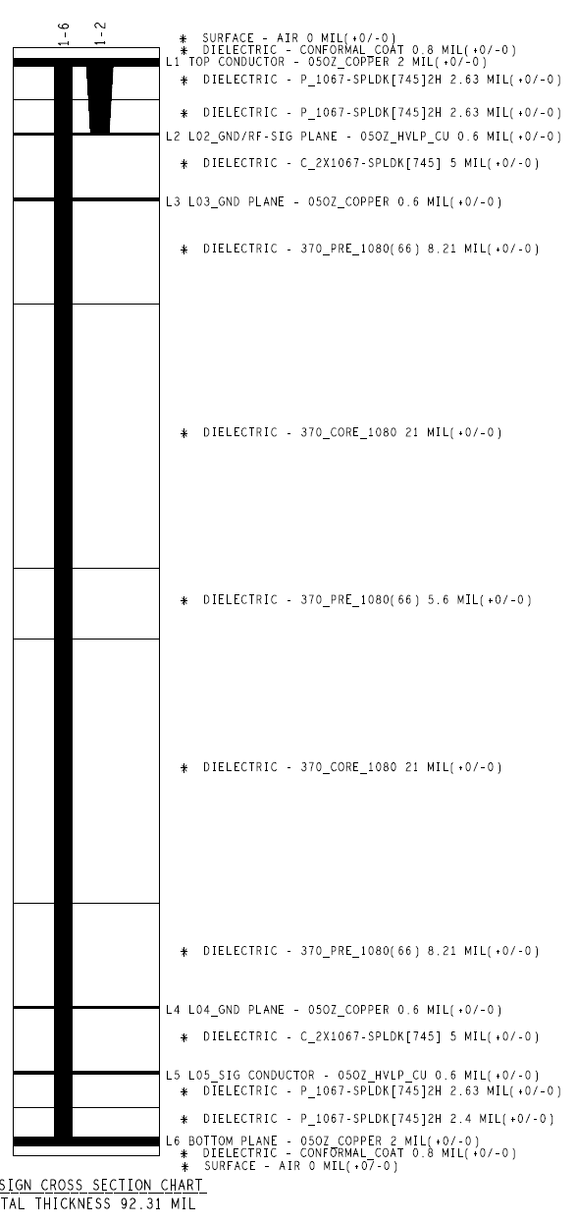
Xilinx XM500 Design

Slide 4
Arch1
CPLD
Digital IO
JTAG
ADC CLK1,2,3,4
LPAM
ADC Input
BALUN
LPAM
DAC Output
BALUN
DAC CLK1,2
Regulator
Digital IO

Slide 5
Arch2
Digital IO
JTAG
ADC CLK1,2,3,4
LPAM
ADC Input
BALUN
LPAM
DAC Output
BALUN
DAC CLK1,2
Regulator
Digital IO

Slide 6
DAC output Arch1
12V from RFMC
-has 80pins
-CPLD reamins data after powre down
-core 1.8V, logic 3.3V
JATG
CPLD
XC2C128-7VQG100I
regulator
7V
use IO port as a CPLD clock
1 digital pin
5 digital pins
TC2-72T+
Eliptical filter
PAT1220-C-9DB-T5
ERA-3SM+
RFMC
SMA
output
LPF
attenuator
-0~31.5dB
Amp
+23dB
(P1dB +13dBm)
T-pad
-9dB
balun
-0.5dB
RF SPDT
SMA
output
HMC545A
QPC7522
HSWA2-30DR+
DAT-31A-PP+
or total 13dB attenuator?

Slide 7
DAC output Arch2
reflection -> at least -27dB
12V from RFMC
regulator
Discrete Component
7V
TC2-72T+
2nd Chebysev filter
->Butterworth
ERA-3SM+
RFMC
SMA
output
LPF
PA
+23dB
(P1dB +13dBm)
PI-pad
-13dB
balun
-0.5dB
RF SPDT
SMA
output
HMC545A
QPC7522
HSWA2-30DR+
or total 13dB attenuator?

Slide 8
Regulator
12V0 -> 7V0
12V0 -> 3V0
12V0 -> 2V5

Slide 9
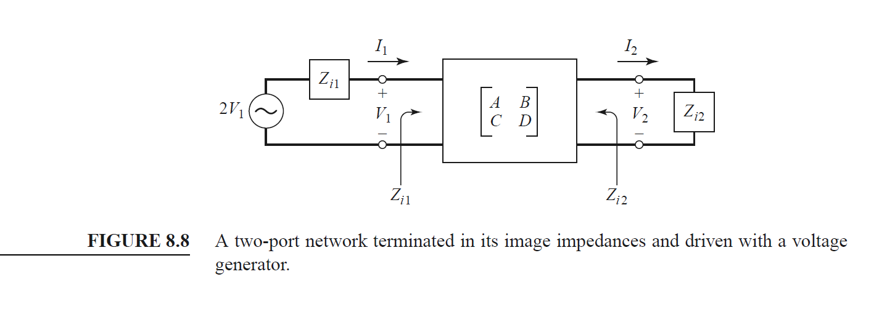
-13dB PI pad
106R07
78R84
78R84
BALUN
78R84
78R84
106R07

Slide 10
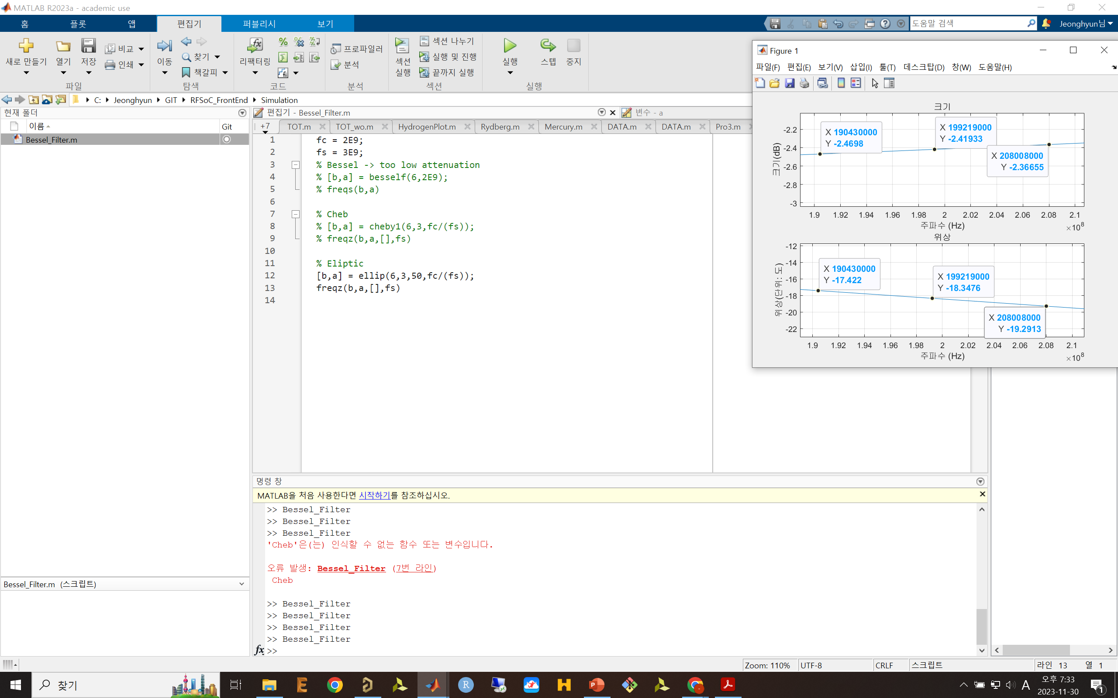
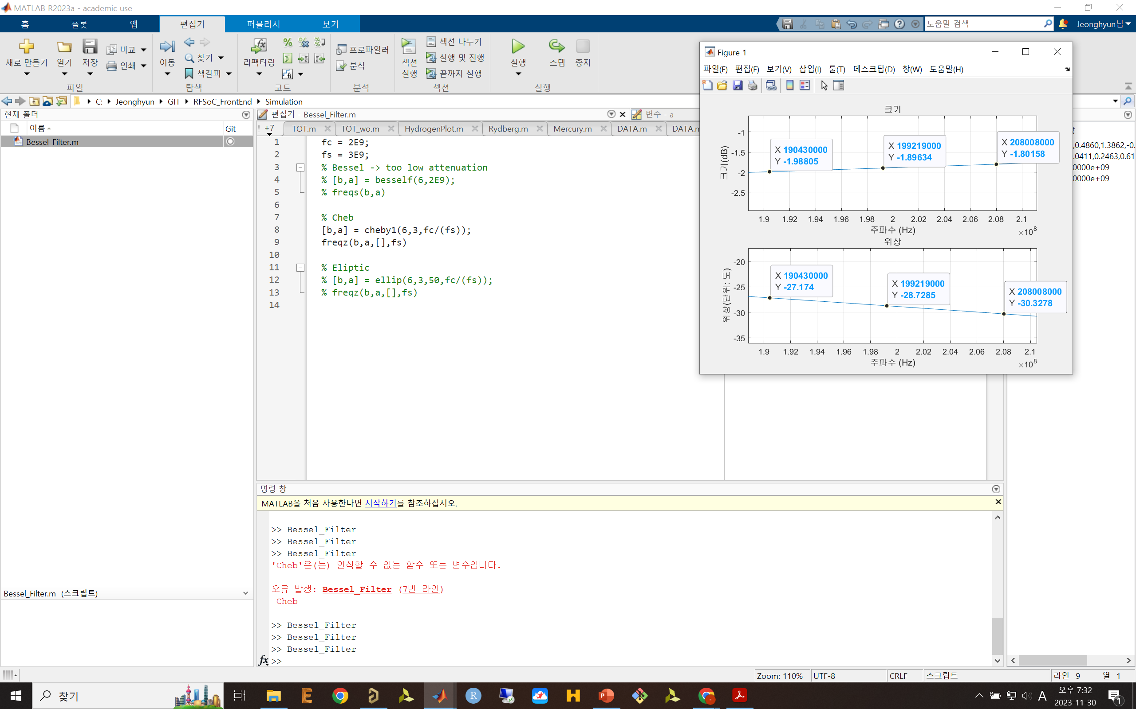
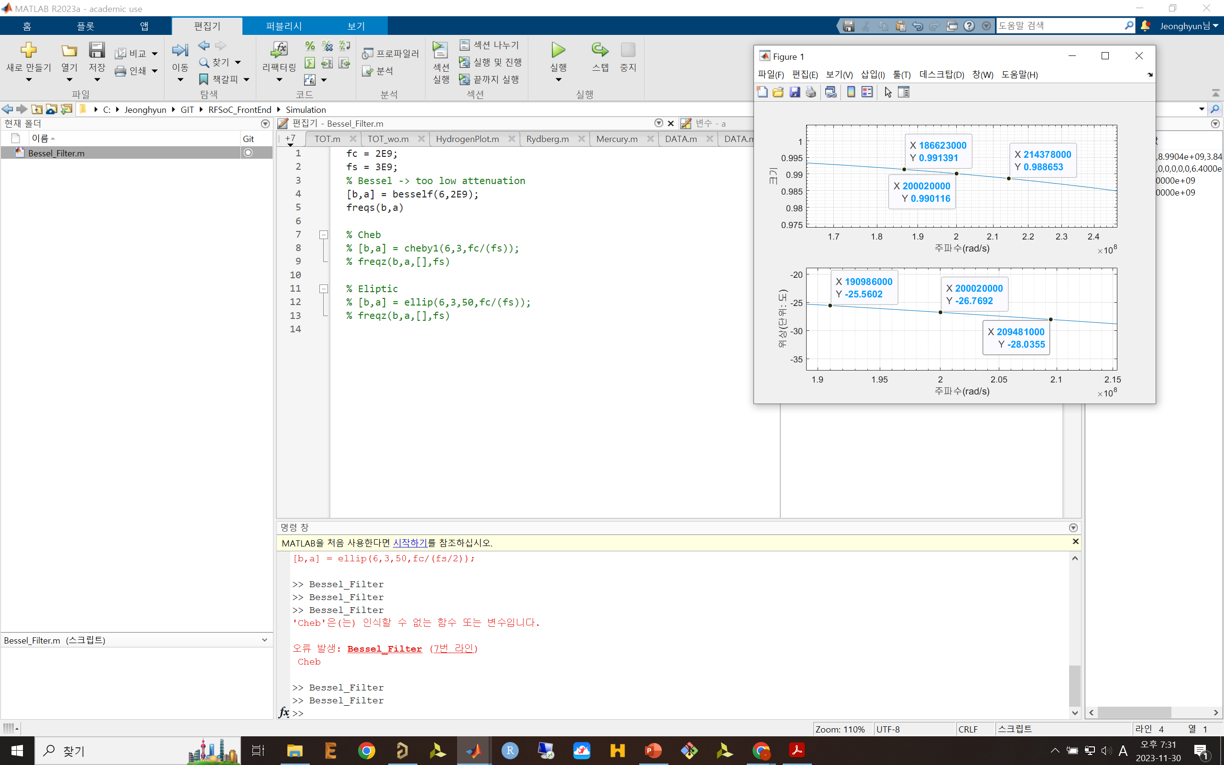
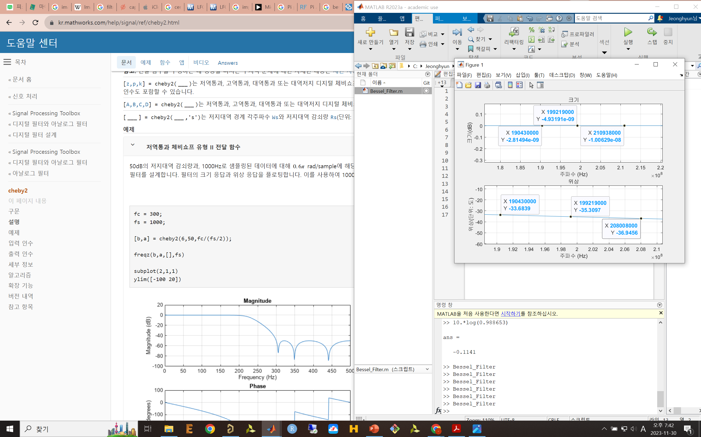

Slide 11
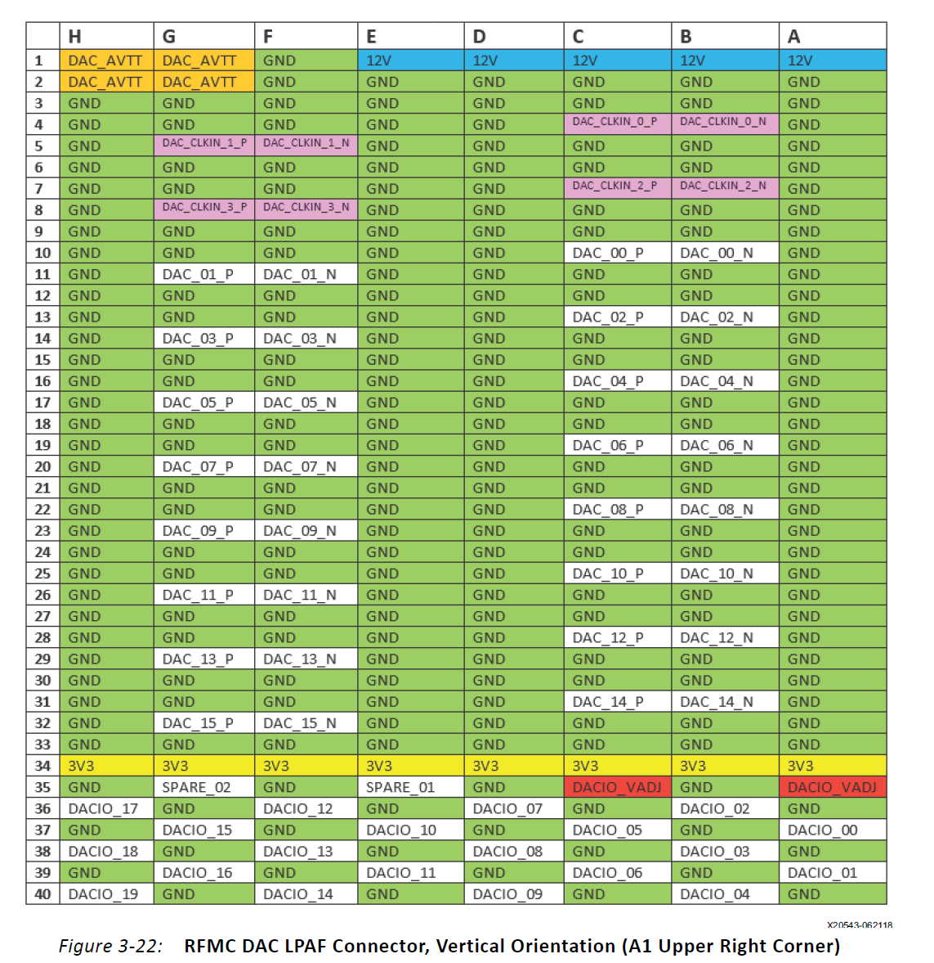
2.5V in 20mA
3.0V in 32mA
1.8V
8ns resolution

Slide 12
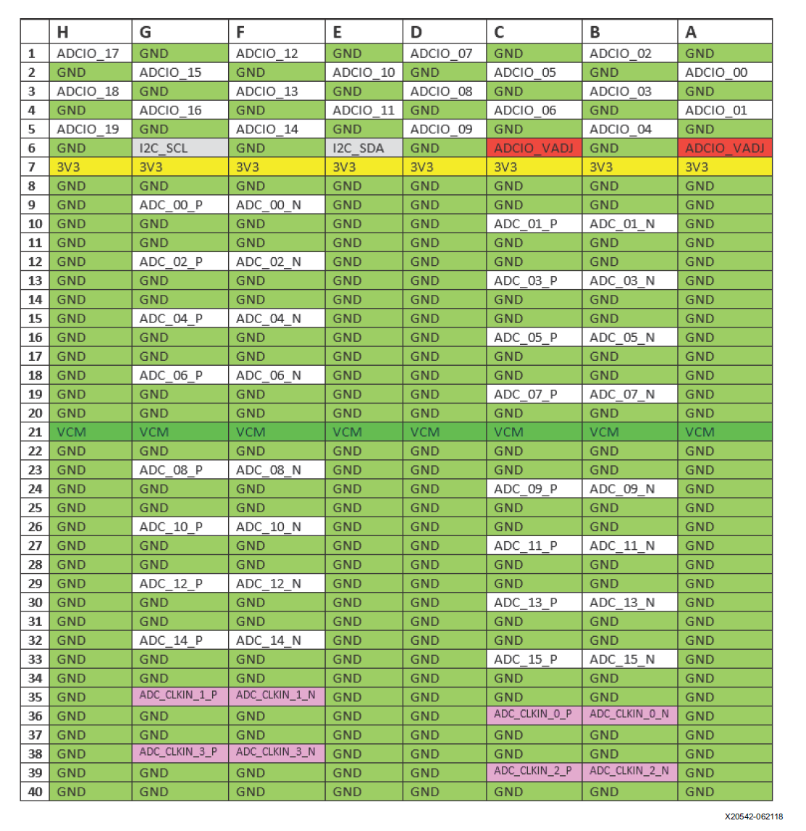

Slide 13
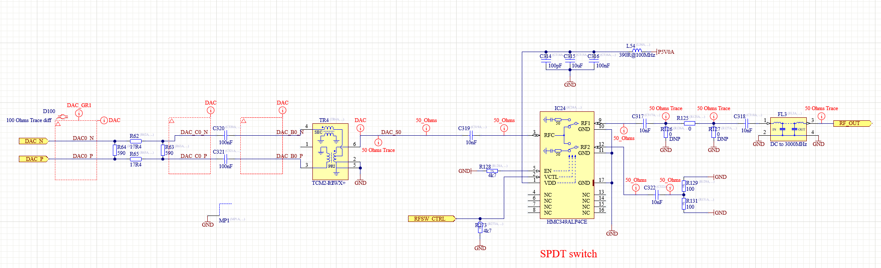
Artiq RFSoC SAWG
-No Amp, only a filter exists

Slide 14
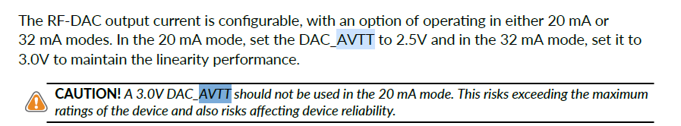
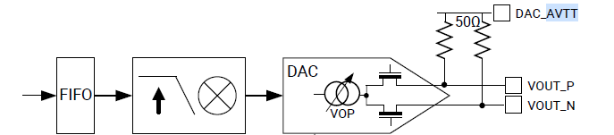
DAC_AVTT Connection

Slide 15
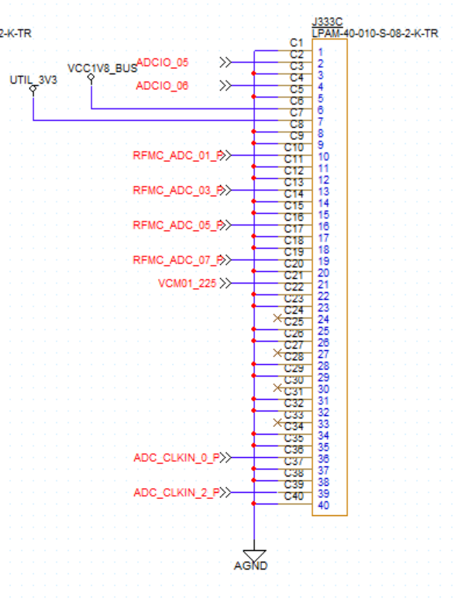
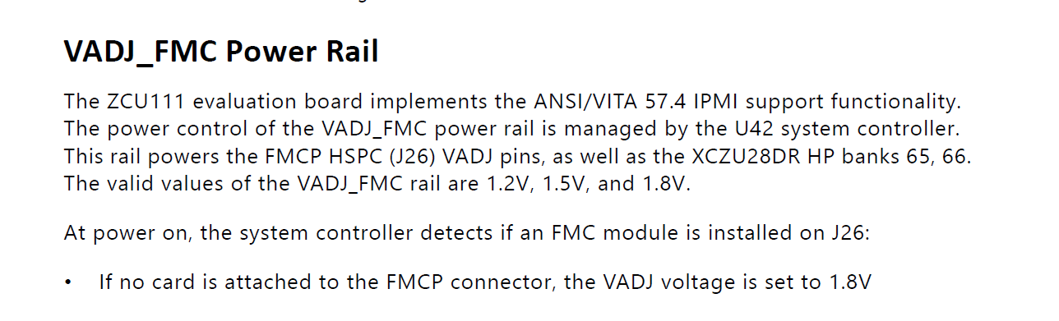
VADJ connection
Connect to 1.8V

